Slide 1

1. The algorithm principles and structures of convolutional neural networks 2. The appliances of convolutional neural networks 3. The strengths and weaknesses of convolutional neural networks
CNN in deep learning
By YU ZHENGYUN
LIN QIAOLING
LI HANYANG

Slide 2
The algorithm principles and structures of cNN
By Yu Zhengyun

Slide 3

outline
What convolutional neural network (CNN) is?
How CNN works?
images using convolutional layers

Slide 4
What is convolutional neural network (CNN) ?
MACHINE LEARNING
DEEP LEARNING
CNN
CNN is one of the representative deep learning neutral networks
Deep learning is a subset of machine learning.

Slide 5
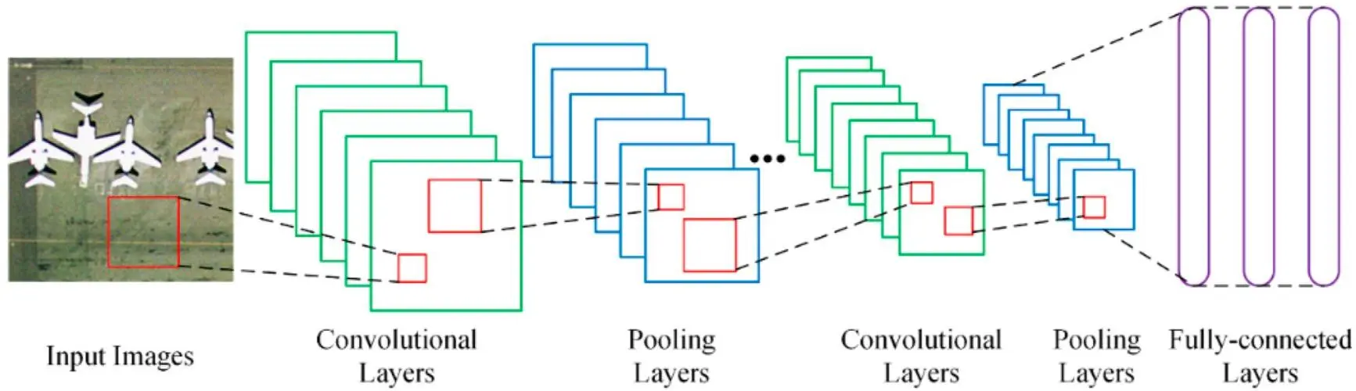
How CNN works ?
Convolutional layer
Pooling layer
Fully-connected (FC) layer

Slide 6
Convolutional layer
Input image
filter
Output array

Slide 7
Convolutional layer
convolution
Rectified Linear Unit (ReLU) transformation
converts the image into numerical values
Input image
filter
Output array

Slide 8
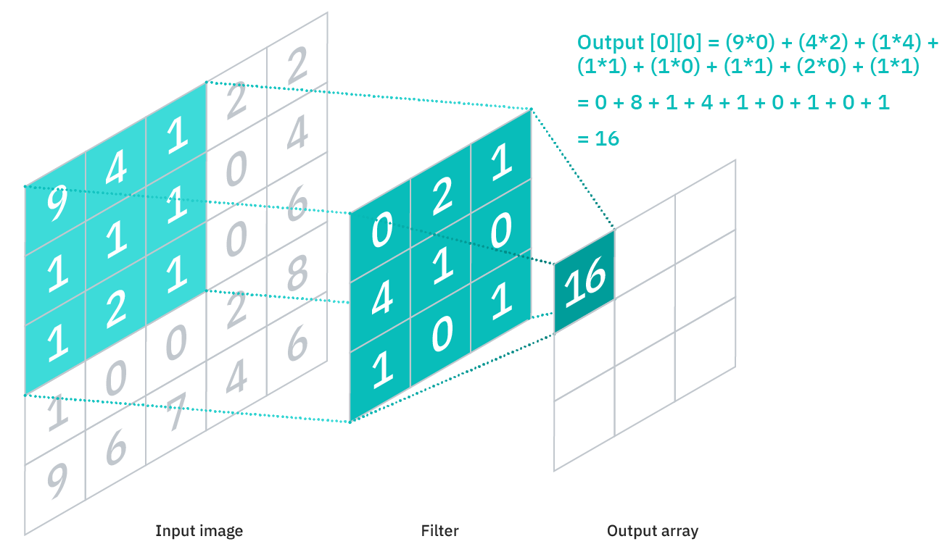
Convolutional layer
convolution
Step 1
Applying the filter
Step 2
Calculate the dot product
Step 3
The filter moves
Respective feild
reapeating
Input image
filter
Output array
```

Slide 9


Convolutional layer
·only need to connect to the receptive field
called “partially connected” layers
·weights in the filter remain fixed
as it moves across the image
parameter sharing
Some parameters update during training through the process of backpropagation and gradient descent.

Slide 10
Convolutional layer
three hyperparameters which affect the volume size of the output
The number of filters
affects the depth of the output
2. Stride
the distance that the filter moves over the input matrix.
3. Zero-padding
sets all elements that fall outside of the input matrix to zero.

Slide 11
Convolutional layer
convolution
introduce nonlinearity to the model.
Rectified Linear Unit (ReLU) transformation
converts the image into numerical values
Input image
filter
Output array

Slide 12
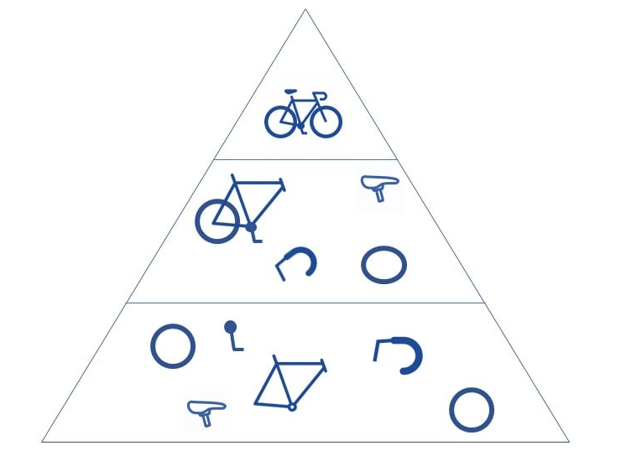
Convolutional layer
Structure of hierarchy within CNN

Slide 13
Convolutional layer
convolution
Rectified Linear Unit (ReLU) transformation
converts the image into numerical values
Input image
filter
Output array

Slide 14

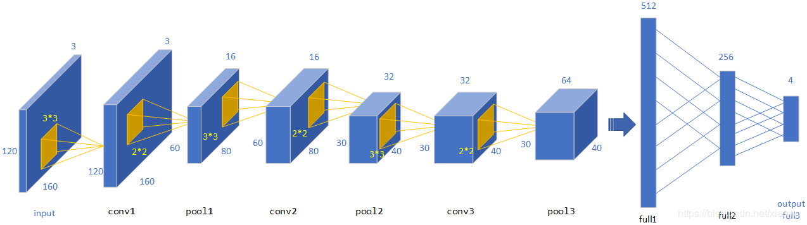
Pooling layer

Slide 15
Pooling layer
usage: reduce the number of parameters in the input.
Similarity:
sweeps a filter across the entire input
Difference:
applies an aggregation function to the values in the receptive field
Benefits:
help to reduce complexity, improve efficiency, and limit risk of overfitting.
```
Max pooling
Average pooling

Slide 16
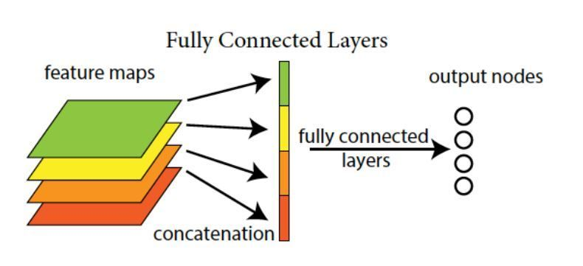
Fully-connected layer

Slide 17
Fully-connected layers
usage:
performs the task of classification based on the features extracted through the previous layers and filters.
Difference:
1）each node in the output layer connects directly to a node in the previous layer
2）use a softmax activation function to produce a probability from 0 to 1

Slide 18
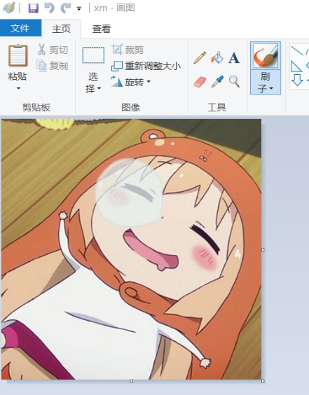
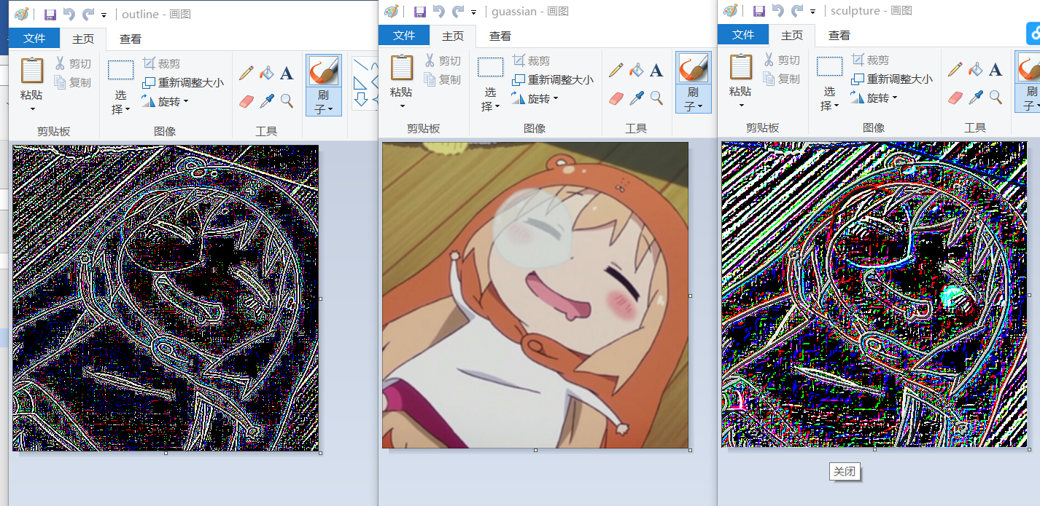
images using
convolutional layers
Outline filter
Guassian filter
Sculpture filter
Original image

Slide 19
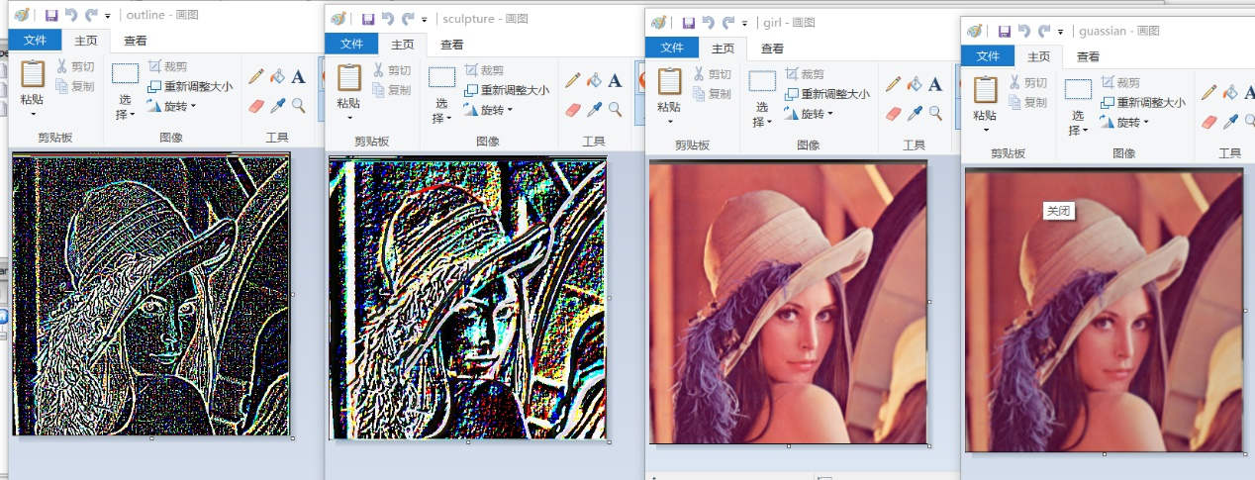
images using
convolution layers
Outline filter
Sculpture filter
Original image
Guassian filter

Slide 20
The appliances of cNN
By Lin Qiaoling

Slide 21
Applications of Convolutional neural networks in computer vision
tag friends in photo albums
identify cancerous tumors
recommend items
lane line detection

Slide 22
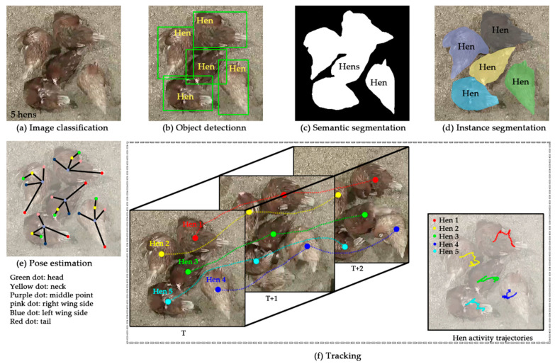
CNN-based computer vision systems in animal farming
Figure 1. Example illustrations of six computer vision tasks. The semantic and instance segmentations were combined as semantic/instance segmentation due to many similarities, resulting in the major five computer vision tasks throughout the study
-Practices and Applications of Convolutional Neural Network-Based Computer Vision Systems in Animal Farming. 2021 Feb 21.

Slide 23
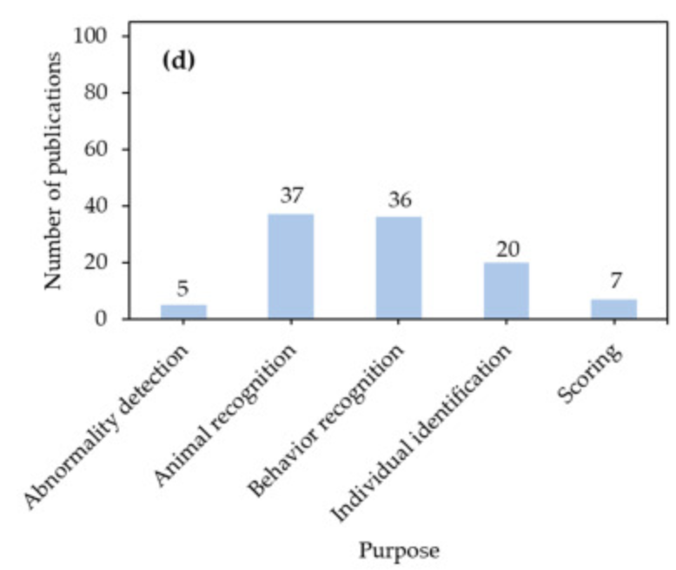
CNN-based computer vision systems in animal farming
Figure 2. Number of publications based on (d) purpose.
-Practices and Applications of Convolutional Neural Network-Based Computer Vision Systems in Animal Farming. 2021 Feb 21.

Slide 24
The strengths and weaknesses of cNN
By Li Han Yang

Slide 25
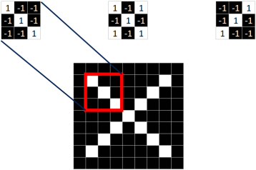
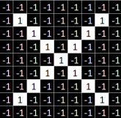
Strength
Better Solving High-dimensional problems
When dealing with high-dimensional problems such as high-res pictures, the increase of dimensions could cause a huge growth of the size of the data and parameters. Making it harder to effectively process.
Convolutional neural networks use filters with local connectivity to avoid dealing with high-dimensional data. While using shared weights and full-connected layers to ensure performance.
Three 3x3 filters in CNN
More parameters needed in traditional modules

Slide 26
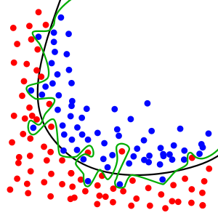
Weaknesses
Large data requirement
Convolutional neural networks usually requires a large amount of training data in order to avoid overfitting.
The figure shows overfitting - the production of an analysis that corresponds too closely or exactly to a particular set of data.
People can train the network on a larger data set from a related domain to try to avoid the problem. Transfer Learning

Slide 27
Thank you
By YU ZHENGYUN
LIN QIAOLING
LI HANYANG

